Slide 1
Engineers in Marketing and Service Activities

Slide 2
Chapter Objectives
• Describe the need for engineers in marketing
• Describe the various ways engineers work in the service industry

Slide 3
Chapter Outline Marketing & Engineers
• Types of Marketing Relationships
• Engineering Involvement in Marketing
• After Sales Service Engineers in Service Organizations
• Importance of Service Industries
• Characteristics

Slide 4

Marketing
Identifying customers
Studying customer’s needs
Obtaining opportunity to make an offer
Closing a deal

Slide 5
Types of Marketing Relationships
Generally by
Length of Relationship
Commitment
Transaction-based Relationships
More Sustained Relationships
Highly Committed Relationships

Slide 6
Marketing Functions
Consumer products
Mass production
Major purpose of purchase: Consumption
Uniform requirements (high substitutability)
Small quantity
Industrial products

Slide 7
Engineering Involvement (Industrial products)
Installation
Large, durable custom construction
Selling/design/cost estimation/supervision
Accessories
Short-lived capital goods (equipment)
Designing for general customer (S)
Raw materials
Extractive & agricultural products
Assessment of quality (B)
Process materials
Goods that change form in production
Specifications (B)

Slide 8
Engineering Involvement (Industrial products)
Component parts
Goods that do not lose identity in production
Eng. Design (S) / Introduction to Users
Fabricated items
Custom-made items
Eng. Design/ Specifications (B)
Bids (S)
Maintenance/Repair/Operating
Consumed in process of production or use
Parts/Schedule/Procedure/Methods (S)
Services
Incidental use
Sell / Perform

Slide 9

After-Sales Service
Installation
Warranty
Field service
Documentation
Training
Provisioning & providing repair facilities
Providing retrofit, rebuild, & overhaul
Supplying spares & supplies

Slide 10
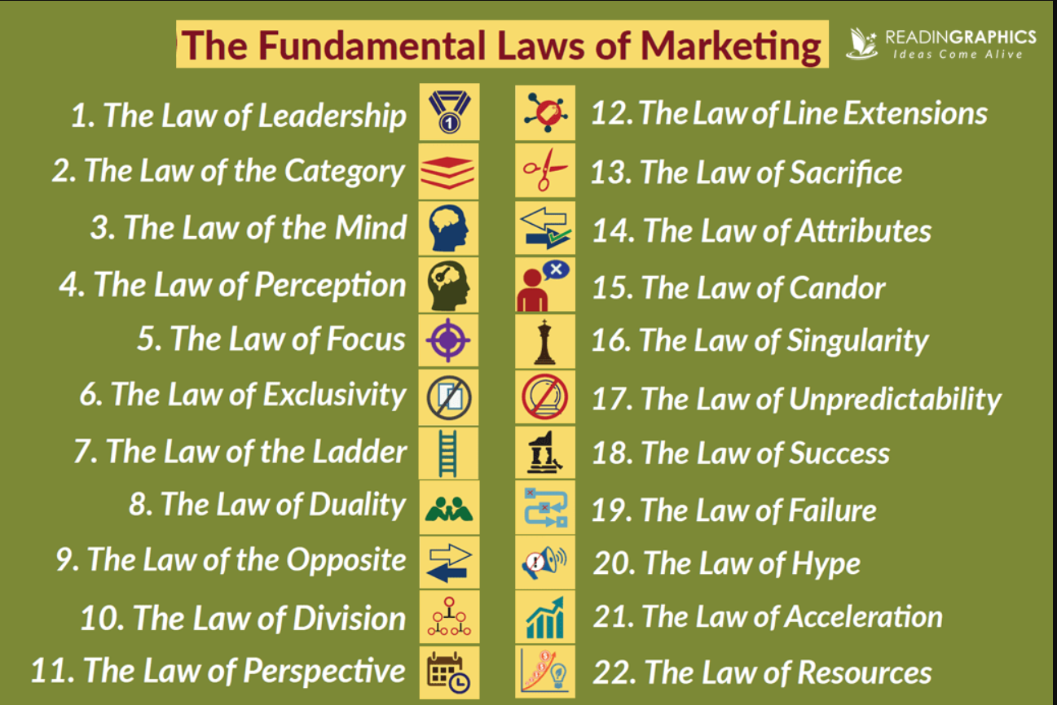
The 22 Immutable Laws of Marketing

Slide 11
Engineers in Service Organizations
Employment in “Goods producing” sector remain basically the same level (total #) from ‘ 86 to ‘ 96, and 2006 (projected), which represents 22. 0%, 18. 5% and 16. 2% respectively
Employment in “Service producing” sector increased from 74 M (‘ 86) to 94 M (‘ 96), and 112 M (2006, projected), which represents 66. 6%, 71. 2% and 74. 1% respectively

Slide 12
Top 10 Industries in Projected Employment Growth
Computer & data processing services (7. 6%)
Health services (5. 3%)
Management & public relations (4. 8%)
Misc. transportation services (4. 8%)
Residential care (4. 8%)
Personnel supply services (4. 3%)
Water & sanitation (4. 2%)
Individual & misc. social services (4. 1%)
Offices of health practitioners (3. 9%)
Amusement & recreation services (3. 5%)

Slide 13
Top 10 Industries in Projected Employment Declining
Coal mining (-6. 0%)
Watches, clocks, and parts (-4. 0%)
Footwear, except rubber and plastic (-4. 0%)
Search & navigation equipment (-3. 8%)
Crude petroleum, natural gas (-3. 7%)
Luggage, handbags, & leather products (-3. 6%)
Tobacco products (-3. 1%)
Metal cans & shipping containers (-3. 1%)
Tires & inner tubes (-2. 9%)
Photographic equipment & supplies (-2. 6%)

Slide 14
Technical Employment in Service Sector
About 22% of engineers worked in service producing industries (educational, research, consulting, hospitals & computing) ]
About 14% of engineers worked for government (highway & other public works, DOD, DOE, NIST)
About 6% of engineers worked in transportation, communication, & public utilities
About 5% of engineers worked in wholesale, retail trade, & FIRE (finance, insurance, & real estate)

Slide 15
Characteristics of Service Sector
More intangible
Performed in real-time (scheduling)
Most professional & consulting services are customized, personalized, & labor intensive
Infrastructure (electricity, transportation, communication, etc. ) providers are capital intensive

